Slide 1
MASTERMIND RIVALS
Felix Saul
Max
Mastermind Inc.

Slide 2
Concept
Soldier
Mastermind
Arena
KILL MASTERMIND
KILL ENEMY PLAYERS
CONTROL AREAS
PROVIDE SUPPORT
INTERACT WITH MAP
SURVIVE
TURRETS
HEALS
AMMO
ENVIRONMENT
Mastermind is a 4v4 third-person shooter with 2 extra player called mastermind who sits at the beginning of each bases. The goal of the game is to destroy the opponent mastermind. The mastermind works like a support hacker closing/opening door for its allies dropping loot on them such as extra ammunition.
Mastermind Inc.

Slide 3
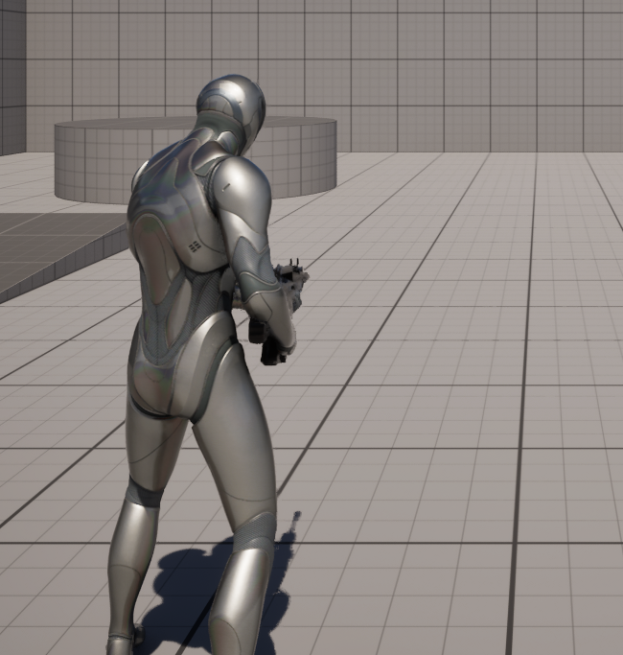
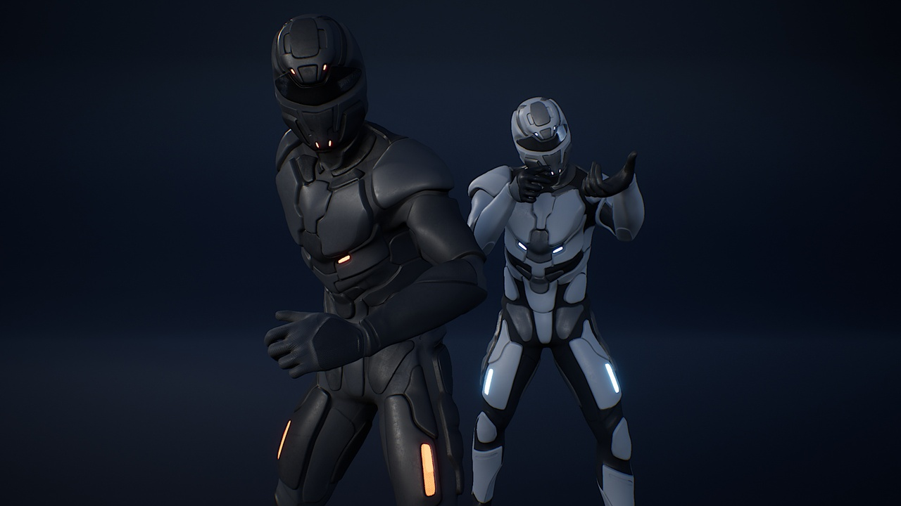

Soldier
There is 4 soldier in each team with the role of destroying the opponent mastermind. They provide vision for their mastermind as well as being able to take control of area that give their mastermind bonuses.
Mastermind Inc.

Slide 4

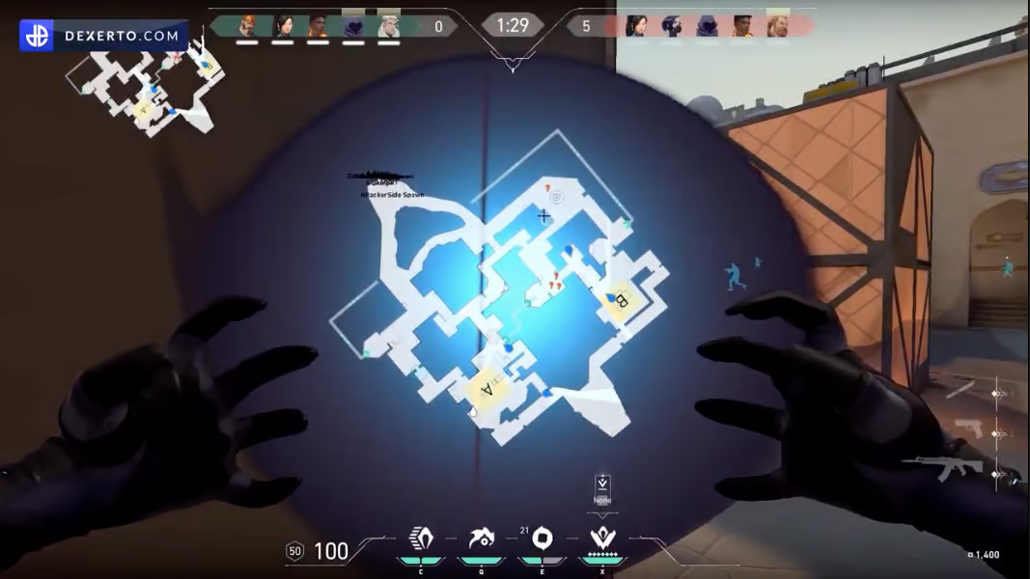
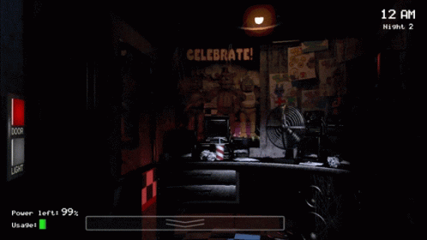
Mastermind
Mastermind look at the game through a screen were they can see the entire map and their ally soldiers. They can hack part of the map to help their allies such as opening or closing doors, pinging their allies to guide them and teleporting loot crate to an ally soldier.
Mastermind Inc.

Slide 5
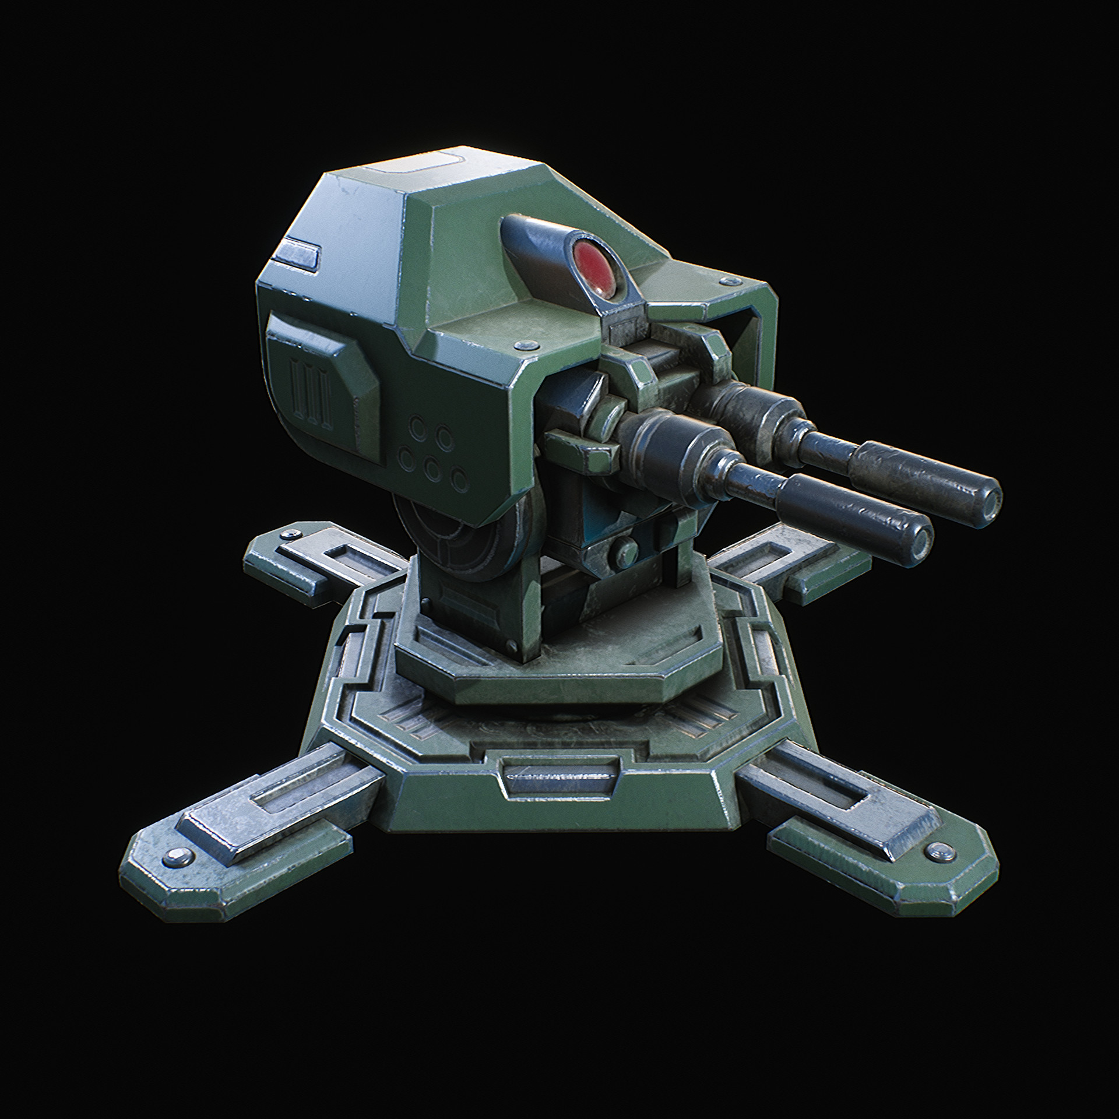
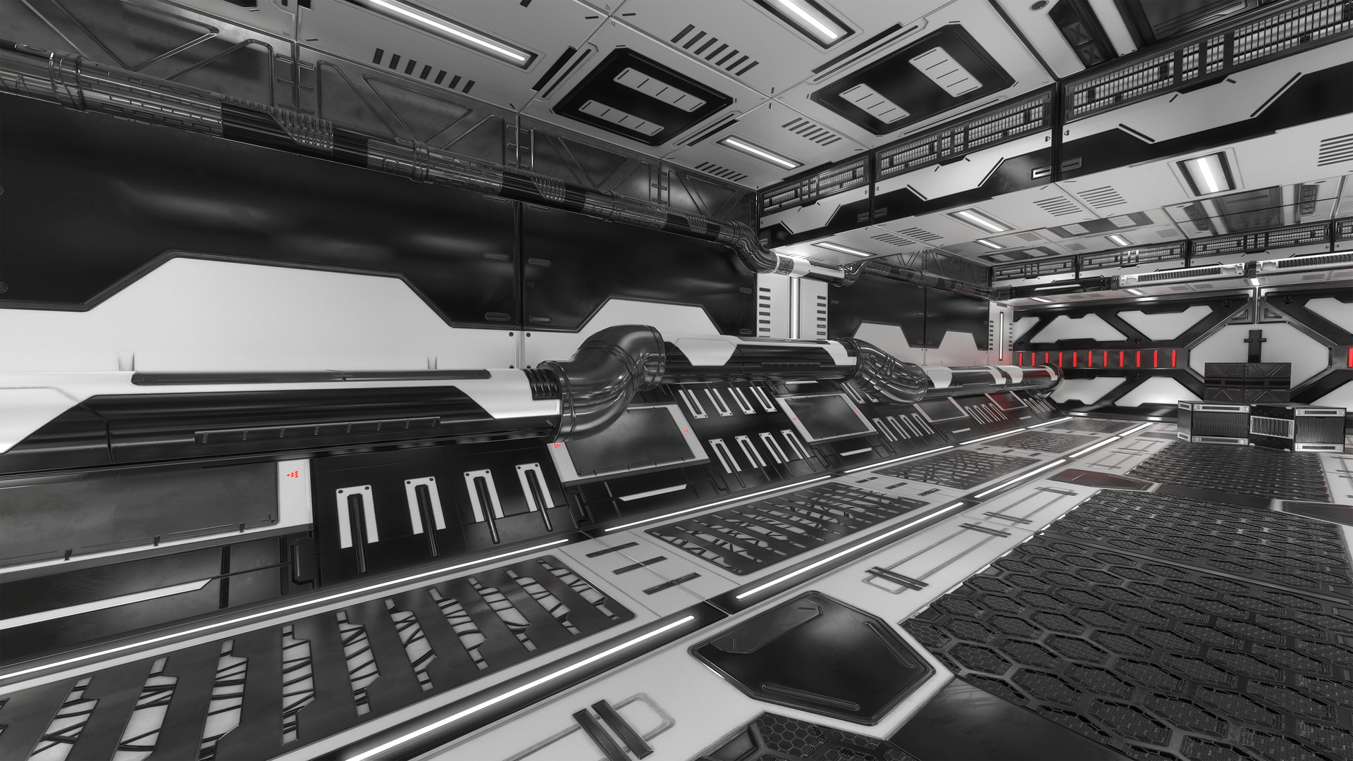

Arena
The arena is going to be a sort of militaristic sci fi base with ton of things for the mastermind to interact with.
Doors
Walls
Platforms
Turrets
Heals
Ammo
Traps
Mastermind Inc.

Slide 6
Turret
Objective Area
Door
Mastermind 1
Mastermind 2
Turret
Objective Area
Door

Slide 7
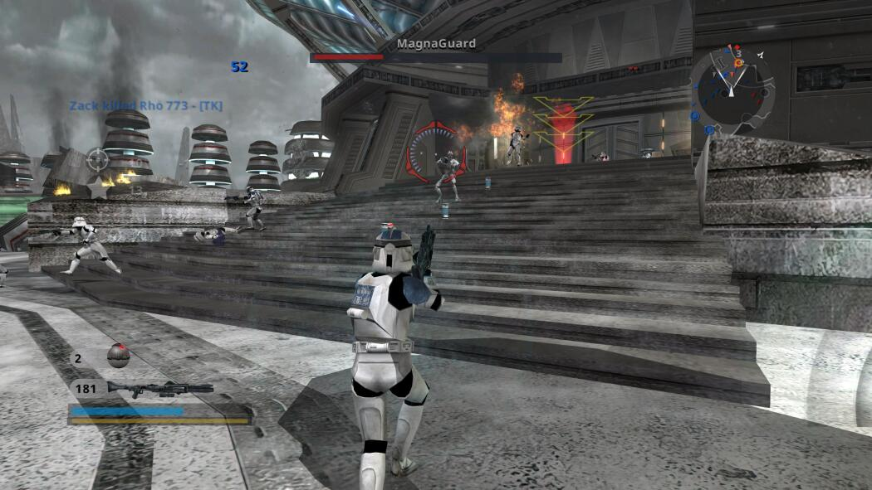

Target audience
Gamers who enjoy third person shooters
Generation Z

